Slide 1
Contract Incentives Under Uncertainty
Data Driven Contract Geometry Best Practices

Slide 2

Meet the Presenter
Peter Braxton
Senior Cost Analyst

Slide 3
Contracts Risk Framework, Part 1
“Filtered” by contract geometry
Take advantage of Contracts Database (KDB) as a rich data source within CADE
  Contract geometry requires backfill effort
Establish an analytical framework for Contracts Risk that takes into account incentive structures (Contract Geometry)
  Government perspective (Price) as well as Contractor perspective (ROS)
  Analyzing historical growth as well as projecting future risk and uncertainty
Apply data mining techniques to KDB to discern when different contract types and geometries were being applied appropriately (or inappropriately)
  Challenge to relate to quantitative (CGF) or anecdotal (SME) measures of contract success
On-shareline
Contract cost
Off-shareline
Contracts Database (KDB)
Non-Contract cost
Program Risk (SAR)

Slide 4
The Role of Contract Incentives
Better Buying Power (BBP) and Incentives
  Basic principle: Encourage and reinforce desired behaviors
  The “pressure” of losing work leads to more prudent management, more dedicated staffing, and efforts to contain costs
  Types of incentives: Cost, Performance, Schedule
Incentive Contracting Basics
  Incentive contract types:
  Fixed Price Incentive (FPI) with both Firm and Successive targets
  Cost Plus Incentive Fee (CPIF)
  Cost Plus Award Fee (CPAF)
  Share ratios for FPI and CPIF establish
  cost risk ratio between Government
  and Contractor
  Cost overrun (above the shareline) results in
  price increase for Government and profit
  decrease for Contractor according to
  established share ratio
  Cost underrun (below the shareline) results in
  price decrease for Government and profit
  increase for Contractor according to
  established share ratio

Slide 5
Contract Incentives Considerations
“Contract Type” is a misnomer
  Actually applies at the Contract Line Item Number (CLIN) level
  Common for a contract (or delivery order) to have multiple CLINs across multiple contract types
“Incentive-Type Contracts” is a misnomer
  All contract types provide an incentive to control costs
  It’s just a matter of degree and timing (incremental change)
Utilizing the Full Spectrum of Contract Incentives
  When is it appropriate to use each contract type?
  How we can most effectively establish the contract geometry for each?

Slide 6
Differences in Cost and Risk Analysis and Contract Management
Profit/Fee in Cost Analysis
  Typical approach for cost analysts is to estimate “at cost” and tack on a fee
  The problem: improperly models percentage fee or profit as invariant with cost in typical risk analyses
  Contract geometry would be incorporated where known (or reasonably estimated) for major contracts
  Cost risk and uncertainty are run through the “filter” of contract geometry to determine the resultant distribution of both Price and Margin
  To further refine, we’d want to model the separation of on-shareline and off-shareline growth
Profit/Fee in Historical Cost Growth Analysis
Profit/Fee in Contract Management

Slide 7
Differences in Cost and Risk Analysis and Contract Management
Profit/Fee in Cost Analysis
Profit/Fee in Historical Cost Growth Analysis
  Where do the cost risk distributions come from in the first place? -Historical cost growth analysis
  Contract geometry often produces counterintuitive distributions (Price, Margin)
Profit/Fee in Contract Management

Slide 8
Differences in Cost and Risk Analysis and Contract Management
Profit/Fee in Cost Analysis
Profit/Fee in Historical Cost Growth Analysis
Profit/Fee in Contract Management
  The Profit/Fee are subject of negotiations and the application of “weighted guidelines”
  Focus: avoid excessive profit
  Ideally, the reconciliation of cost risk analysis and negotiation of contract geometry would occur in conjunction with each other and not in isolation
  The Government is coming to a realization that there is an inherent trade-off for the corporations between target fee and risk position of the bid

Slide 9
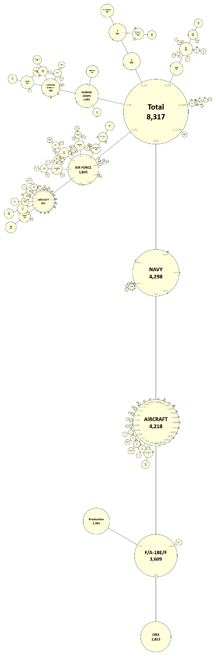
Contracts Database (KDB) as a Resource
KDB Current Status
  Over the years, KDB thought leadership and sponsorship has come from multiple sources:
    Air Force Cost Analysis Agency (AFCAA)
    Marine Corps Program Executive Office Land Systems (PEO LS)
    Office of the Deputy Assistant Secretary of the Army for Cost and Economics (ODASA-CE)
    Naval Center for Cost Analysis (NCCA)
  Currently, KDB is under the aegis of Cost Assessment Data Enterprise (CADE)
    Further ensures alignment with broader cost community data needs
KDB Scope
  KDB provides CLIN-level price, quantity, and schedule data
  All changes tracked by individual modifications
  Backfill effort to break out price into cost and fee, where possible (CPFF, CPAF, CPIF, FPIF)
  Total contract value in KDB exceeds half a trillion dollars
  Initial focus was Missiles and Munitions
  Many other commodities have since been added: Aircraft, Electronics, Wheeled and Tracked Vehicles, AIS, etc.

Slide 10
Price Growth Categories vis-à-vis the Shareline
CLIN-level Cost, Fee, and Price data enable Profitability Analysis
  Profitability analysis within CADE is a key area for data fusion between KDB and Contractor Cost Data Reports (CCDRs)
  Table below shows classification of mods to attribute price changes to one of the Growth Categories
  In theory, Cost and Schedule mods should constitute on-shareline growth whereas Baseline and Technical mods would constitute off-shareline growth
Price Growth Categories
Baseline | for all modifications where anticipated changes impact the contract value.
Cost | for all modification where unanticipated price changes with no change in scope impact the contract value
Technical | for all modifications where unanticipated scope changes impact the contract value
Schedule | for all modifications where unanticipated schedule changes impact the contract value
Administrative | for all modifications that do not change the overall contract price

Slide 11
Prevalence of Major Contract Types
Benchmarks for Contract Type
  FFP an order of magnitude more prevalent than CPFF
  CPFF in turn an order of magnitude more prevalent than Incentive-type
Benchmarks for Contract Geometry Parameters
  Need to backfill and mine KDB at the CLIN level to obtain useful data for characterizing contract geometry parameters
  Such parameters include: target fee percent; ceiling price percent; share ratios (over and under); min and max fee (percentages); and base fee and award fee (percentages)
  Desired computations: initial and final margin percentage (or equivalently Return of Cost) for all CLINs, would show the impact of mods on profitability over time
Contract Types in KDB
Contract Type | Count | Value | By Count | By Value | Average Size
CPAF | 632 | $ 51,012,918,376.09 | 1.1% | 12.9% | $80,716,643.00
CPIF | 665 | $ 24,081,165,007.56 | 1.2% | 6.1% | $36,212,278.21
FPIF | 1,296 | $ 70,482,041,186.76 | 2.3% | 17.8% | $54,384,291.04
FFP | 40,446 | $ 167,832,774,252.10 | 71.5% | 42.4% | $4,149,551.85
COST & CPFF | 6,949 | $ 29,755,157,311.01 | 12.3% | 7.5% | $4,281,933.70
Other | 6,559 | $ 52,434,424,590.58 | 11.6% | 13.3% | $7,994,271.17
Total | 56,547 | $ 395,598,480,724.10 | 100.0% | 100.0% | $6,995,923.40

Slide 12
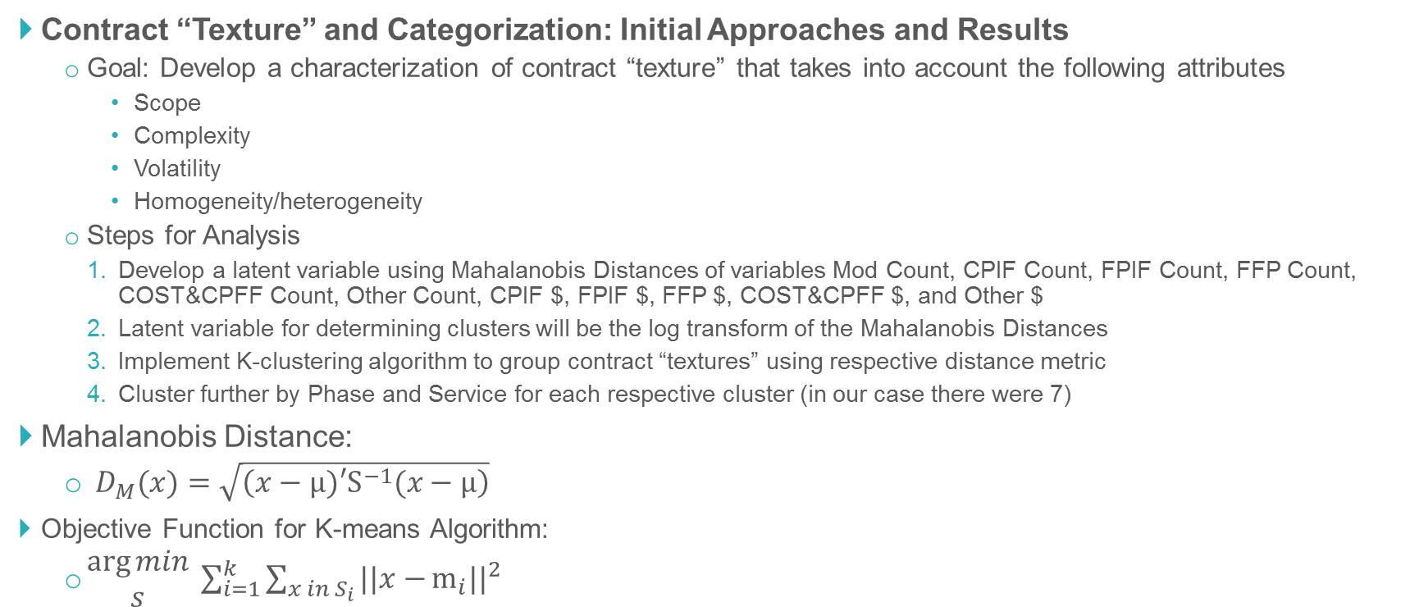
Contracts Database (KDB) as a Resource
Contract “Texture” and Categorization: Initial Approaches and Results
  Goal: Develop a characterization of contract “texture” that takes into account the following attributes
    Scope
    Complexity
    Volatility
    Homogeneity/heterogeneity
  Steps for Analysis
    Develop a latent variable using Mahalanobis Distances of variables Mod Count, CPIF Count, FPIF Count, FFP Count, COST&CPFF Count, Other Count, CPIF $, FPIF $, FFP $, COST&CPFF $, and Other $
    Latent variable for determining clusters will be the log transform of the Mahalanobis Distances
    Implement K-clustering algorithm to group contract “textures” using respective distance metric
    Cluster further by Phase and Service for each respective cluster (in our case there were 7)
Mahalanobis Distance:
  $D_{M}(x)=\sqrt{\left(x−µ)′S^{−1}(x−µ\right)}$
Objective Function for K-means Algorithm:
  $\begin{matrix}\arg{min} \\ s\end{matrix} \sum_{i=1}^{k}{\sum_{x in S_{i}}{||x−}}{m_{i}||}^{2}$

Slide 13
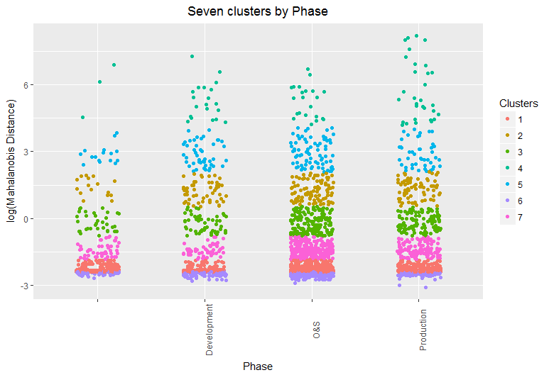
Contracts Database (KDB) as a Resource
Contract Texture Clusters by Phase

Slide 14
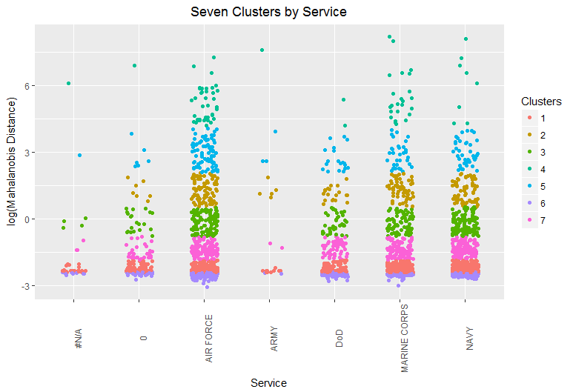
Contracts Database (KDB) as a Resource
Contract Texture Clusters by Service

Slide 15
Historical Cost Growth Analysis and Contract Risk Modeling
On-Shareline Cost Growth and Implications for Price and Margin
  Looking at the “Big Four” contract types (FFP, FPI, CPIF, and CPFF)
  FFP is essentially a 0/100 share ratio
  (the Contractor bearing all the cost risk)
  CPFF is essentially a 100/0 share ratio
  (the Government bearing all the cost risk)
  “On-shareline” occurs on one or more existing CLINs, and the contract modification will change the projected final cost without changing the contract geometry
  This causes revisions in both the price to the government and the contractor’s margin, as the cost change “runs up” the shareline (overrun)
Off-Shareline Cost Growth and Implications for Price and Margin
  This occurs when “new work” is added to some combination of existing and new CLINs in a “profit-neutral” manner
  The contract geometry is then modified to add both cost and fee in the same proportion as in the original CLIN(s)
  The impact of off-shareline growth is illustrated by adding $1M in additional work to our example FPIF contract at the same 10% target fee

Slide 16
Assessing Contract Types and Contract Geometry
Historical Cost Growth by Contract Type
  KDB has an associated Visual Analysis Tool (VAT) that allows us to aggregate historical cost growth metrics by:
    Contract,
    Program,
    Contractor, etc.
  We can also use the KDB Pivot Tool to generate historical cost growth by contract type
Ecclesiastes: To Every Contract Type, There Is a Season
  The greater risk is applying an inappropriate contract type to a given program phase and scope of work
  Diagnosing this with greater fidelity requires a mixture of better metadata and expert judgment
  We should be beware of retroactive diagnoses that rationalize what may or may not have gone better had a different course of action had been chosen
  Like cost analysis, contract management is an “unrepeatable experiment”

Slide 17
Next Steps
KDB Data Collection
  To date, the population of KDB has been a manually intensive process
  Data collection priorities have been directed by the study sponsors over the years
  KDB has sporadic data for some system types (e.g., Ships), and more robust data for others
  By more comprehensively populating other system types, not only do we increase the overall number of usable data points in the database, but we enable comparison between system types to determine whether there are any statistically significant differences between them
KDB Automation
  The automation process uses Python scripts to transfer the contents of each computer-generated PDF file (contract or modification) into a text file (.txt).
  The text files are then “cleaned” and parsed for requisite information and data using R software
  The “cleaned” data is populated into an Excel file, which can then directly feed the master Microsoft Access database
  Automation will greatly increase the speed and accuracy of data acquisition
KDB Future State
  It would be even better to “cut out the middleman” of the PDF and tap directly into the data fields that were used to generate the contract
  Defense Procurement and Acquisition Policy (DPAP) organization has worked with the community to develop a Procurement Data Standard (PDS)
  PDS specifies the XML schema for all information needed to generate a valid contract or mod
  With PDS information directly available, a repeatable mechanism to ingest the requisite data into KDB could be developed to create a more efficient data acquisition process
  However, we will always need “analyst in the loop” for Mod (e.g., Category) and CLIN (e.g., WBS mapping)

Slide 18
Next Steps
Leveraging Data Fusion Via CADE Integration
  There is a tremendous possibility in data fusion between KDB and the current contents of the CADE back-end relational database:
    Cost data from CCDRs (including profit for FFP)
    EVM data from Contract Performance Reports (CPRs) and Integrated Program Management Reports (IPMRs)
    Budget, quantity, contract funding, and contextual major program event data integrated from the Defense Acquisition Management Information Retrieval (DAMIR) system
Revisiting and Reconciling Program and Contract Cost Growth
  It should be straightforward to map KDB contracts to CSDR and EVM reporting contracts in CADE
  On a program-by-program basis, and in aggregate (broken out by Service, Commodity, etc.), we should be able to compare the latest SAR cost growth numbers with those from KDB
  The hope is to yield not only analytical insights but also lesson learned for a tighter integration of cost and risk analysis and contract management functions going forward
Supplementing Contracts Data with CSDR Data
  SAR data in CADE will allow us to cross check historical cost and schedule growth metrics with KDB
  Cost and Software Data Reporting (CSDR) data – CCDRs in particular – present the greatest opportunity for supplementing the cost and profit/fee breakout in KDB
Refining Contract Texture Metrics and Contract Categorization
  We will use a combination of automation, systematic data analysis, and targeted subject matter expert (SME) insight to try to untangle appropriate vs. inappropriate use of contract types
  We can develop rubrics that can serve as guides to encourage appropriate use of contract types and contract geometries, and conversely, to provide warnings of potential inappropriate use

Slide 19
Thank You
pbraxton@technomics.net | 571-366-1431

