Slide 1
Title: Using Quantum Theory, Monte Carlo, and the Multiverse to Predict EAC
Nathan Eskue
Orbital ATK
nathan.eskue@orbitalatk.com
480-528-2097

Slide 2
Expected Key Takeaways for Participants
Learn about the multiverse, Schrödinger's cat(s), and why we can’t factor risks
Explore a better approach to predicting EACs
Review the process of building an EAC Multiverse and simulating using Monte Carlo analysis
Explore a user friendly data model that will create your project’s multiverse

Slide 3
The Burning Platform
Why is successfully predicting an EAC so difficult?
Known risks and opportunities may be realized
Unknown risks and opportunities may be realized
Known risks and opportunities may create new unknown risks and opportunities
Risks and Opportunities might not be realized
Some risks may mitigate others or cause them to realize a chain of other risks
Opportunities may create long term disasters, realizing both known and unknown risks.
Ad nauseam . . .
https://opexsociety.org/body-of-knowledge/real-leaders-never-say-burning-platform/
THE REAL QUESTION IS: WHY DO WE TRY IN THE FIRST PLACE?

Slide 4
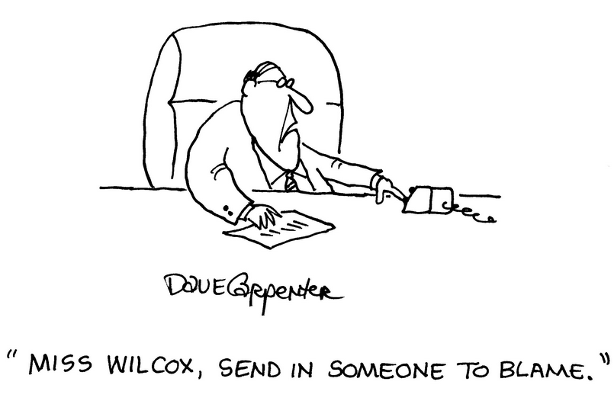
Basic EAC Analysis
We try. . . Because we must
Revenue forecasting
Customer reports
Portfolio management
Stockholder accountability
These things will never go away
However, we provide numbers that have little chance of happening exactly.
Even a Format 1’s best case / worst case / most likely, though better – doesn’t give proper context
https:// julettemillien.com /
SO WHERE DO WE TURN FOR ANSWERS?!
https:// julettemillien.com /

Slide 5
Quantum Primer Part 1: The Cat
We turn . . . to a cat.
"I don't like it, and I'm sorry I ever had anything to do with it.“ - Erwin Schrödinger
http://www.buzzle.com/articles/the-schrodingers-cat-paradox-explained.html
Notes:
The Schrödinger's Cat paradox is a thought experiment that Austrian physicist, Erwin Schrödinger intended as a discussion for the EPR (Einstein, Podolsky, and Rosen) article. The EPR article looked at quantum entanglement, where multiple particles are linked in such a way that when we measure one particle, the quantum states of other particles can be discerned. Schrödinger, who was not in tune with the standard interpretation of quantum physics, in his communications with Albert Einstein came up with the paradoxical thought experiment to disprove the Copenhagen Interpretation. To explain his theory, Schrödinger placed his cat in a steel box (theoretically, of course) which also contains a radioactive substance, a Geiger counter, a small flask of hydrocyanic acid, and a hammer. When the atom of the radioactive substance decays, it is detected by the Geiger counter which, in turn, activates the hammer to release the acid and kill the cat. Since the radioactive atom exists in a state of superposition, where there is 50 percent chance of it having decayed or not, it extends to other events that are related to it. This also applies to the fate of the cat, which as Schrödinger put it, could be "living and dead ... in equal parts" until it is observed. So, according to the quantum theory, the cat could be living and dead simultaneously. The superposition collapses when a person lifts the lid of the box to see whether the cat is dead or alive. This is known observer's paradox or indeterminacy, and it leads to 'decoherence', where the probabilities decohere into a single reality. In this case, the observer or the measurement system is entangled with the experiment. Read more at Buzzle: http://www.buzzle.com/articles/the-schrodingers-cat-paradox-explained.html

Slide 6
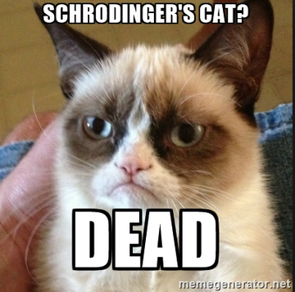
Quantum Primer Part 1: The Cat
Schrodinger’s Cat Alternate Theory
(AKA the pessimist program manager)
http://www.buzzle.com/articles/the-schrodingers-cat-paradox-explained.html

Slide 7
Quantum Primer Part 1: The Cat
Standard EAC analysis for the cat:
Risk: Dead cat
Probability: 50%
CEAC (cat estimate at complete): 0.5 cats
Surely there is a better way. . .
IS THIS WHAT WE’RE GIVING TO OUR CUSTOMERS ?!!
http://www.buzzle.com/articles/the-schrodingers-cat-paradox-explained.html

Slide 8
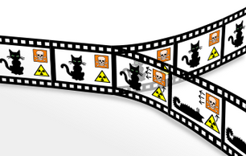
Quantum Primer Part 2: The Multiverse
Quantum theory gives us the answer, which makes more sense:
The cat is both alive and dead--until we observe reality
The probability determines, on average, what will happen
However, the cat will be 100% alive or 100% dead
This requires the universe to split
In one universe, there is a live cat
In another, there is a dead cat
en.wikipedia.org
There is not a universe where there is 0.5 cats
en.wikipedia.org

Slide 9
Quantum Primer Part 2: The Multiverse
SEE? DOESN’T THAT MAKE MORE SENSE?
STAY WITH ME HERE. . .
http://www.buzzle.com/articles/the-schrodingers-cat-paradox-explained.html

Slide 10
Quantum Primer Part 2: The Multiverse
Key takeaways
Every decision causes a split in the universe
Each path is then faced with a new set of decisions, each of which causes a new split
The probability of each outcome determines how many alternate universes have that version of reality
Being able to take a step back and see all possibilities would allow you to have a much better understanding of what actions to take today
We already do this in our own lives! Quick example…
http://mylifesamovie.com/wp-content/uploads/2014/11/o-TALK-ON-PLANE-facebook.jpg?x24560
So how exactly does this apply to my EAC?
http://www.buzzle.com/articles/the-schrodingers-cat-paradox-explained.html

Slide 11
Your EAC Multiverse
Your EAC is a multiverse
Every decision causes a split in the potential EAC
“Decisions” can be captured in the form of R&Os
If you treat your EAC like a multiverse, several things happen
Drives discussions away from whether a top level EAC will happen as predicted
Drives discussion toward the actions that prevent risks and promote opportunities
Looks at your program as it is—a huge number of potential paths and results
Instead of a few numbers, your EAC becomes a cone of probable outcomes
http://www.buzzle.com/articles/the-schrodingers-cat-paradox-explained.html

Slide 12
Your EAC Multiverse
Problem: That is a lot of work. An insane amount of work.
Solution: No, it’s not.
If you focus on the two key elements of your project, the rest is simple.
What are these mysterious elements?
http://www.buzzle.com/articles/the-schrodingers-cat-paradox-explained.html

Slide 13
EAC Multiverse Basics
EAC Multiverse Element #1: The Plan
Baseline and manage the plan with the best available information
You should already be doing this
EAC Multiverse Element #2: A robust a well managed R&O profile
What are all the events (decisions) that can alter “the plan”
What actions prevent (or promote) them?
Do they affect other decisions down the path?
What (and when) are the effects of each decision?
What does it look like if we manage this way?

Slide 14
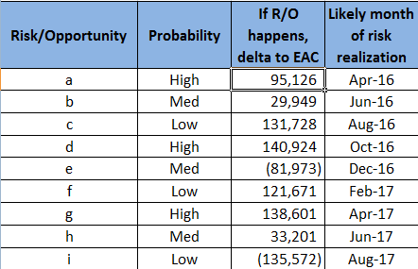
EAC Multiverse Visualized
EAC Multiverse Element #1: The Plan
EAC Multiverse Element #2: A robust, well managed R&O profile
http://www.buzzle.com/articles/the-schrodingers-cat-paradox-explained.html

Slide 15
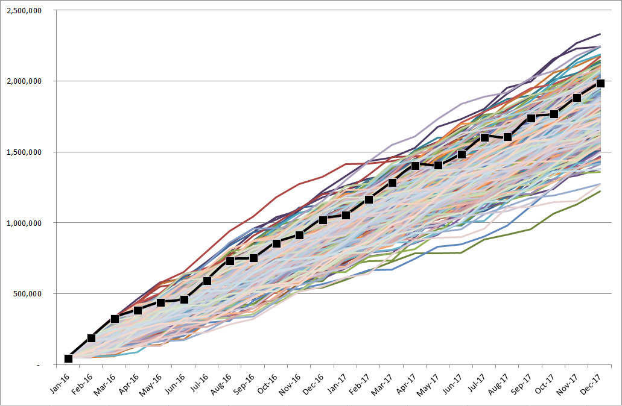
EAC Multiverse Visualized
EAC Multiverse Result
If every possible combination of outcomes were mapped and tracked, it would look like:
http://www.buzzle.com/articles/the-schrodingers-cat-paradox-explained.html

Slide 16
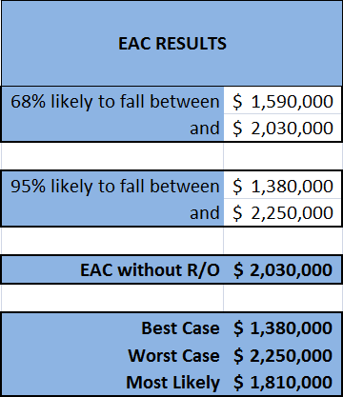
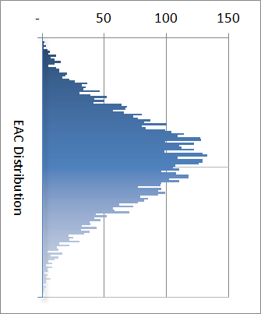
EAC Multiverse Visualized
EAC Multiverse Result
If we did this over and over again, accounting for the probability of each R/O and therefore the probability of each individual path, we’d be able to determine with very strong certainty:
http://www.buzzle.com/articles/the-schrodingers-cat-paradox-explained.html

Slide 17
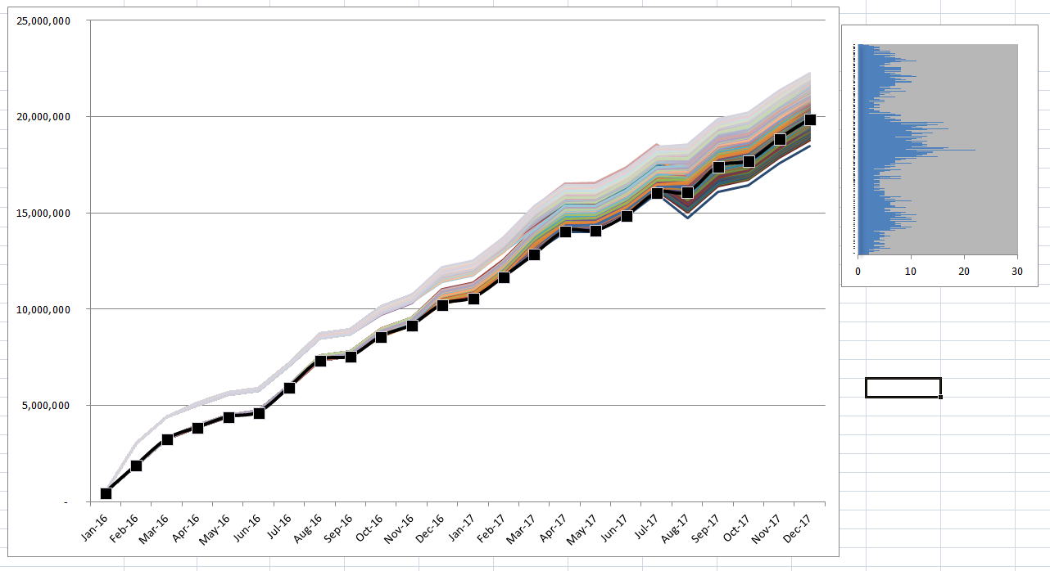
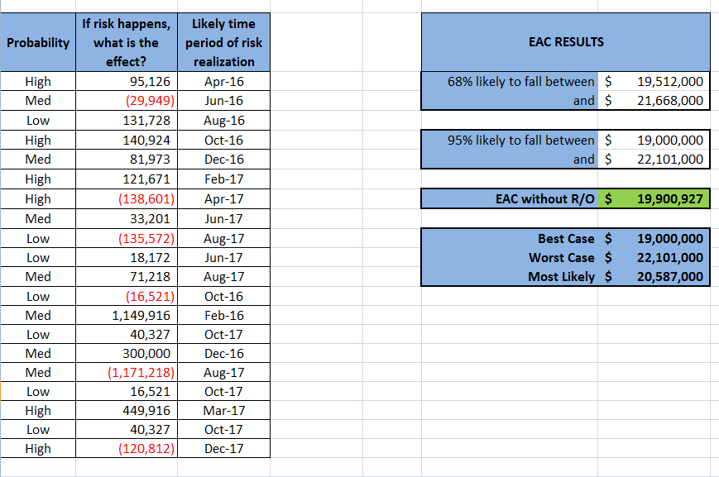
EXAMPLES

Slide 18
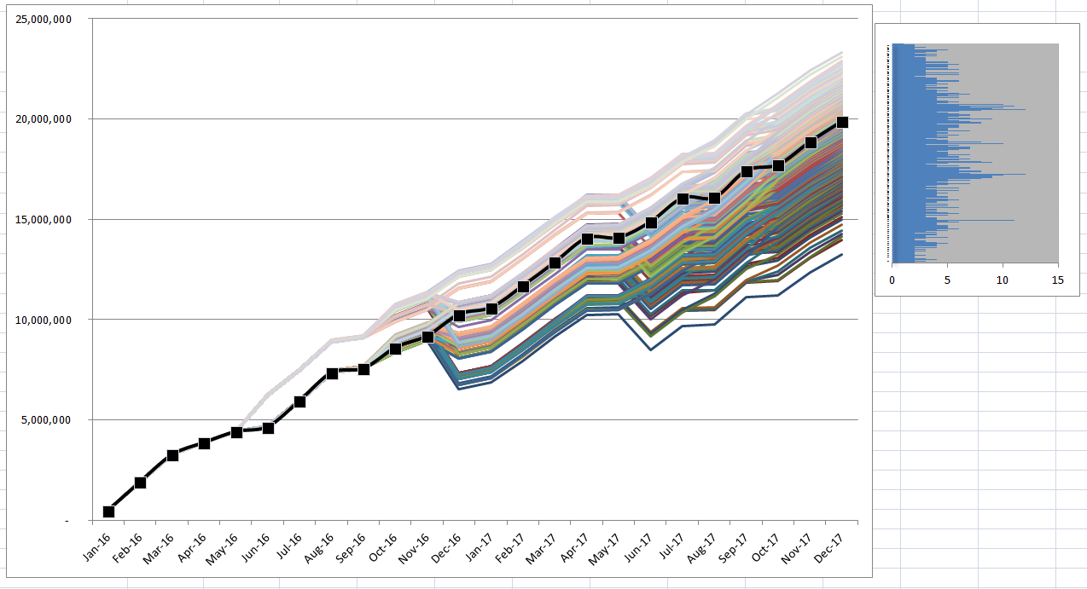
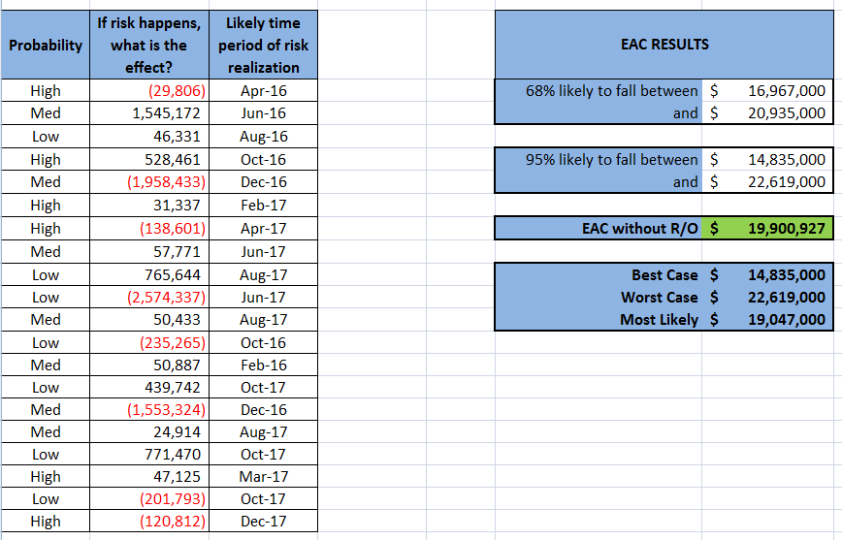
EXAMPLES

Slide 19
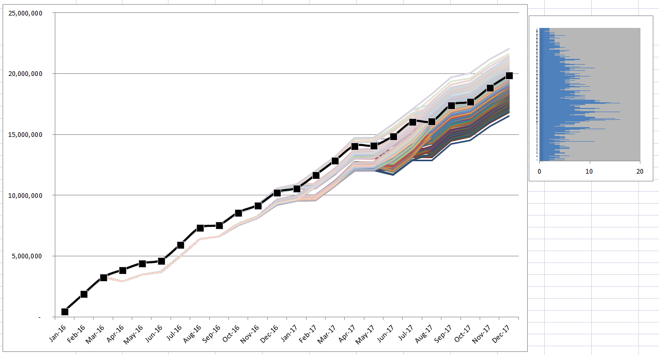
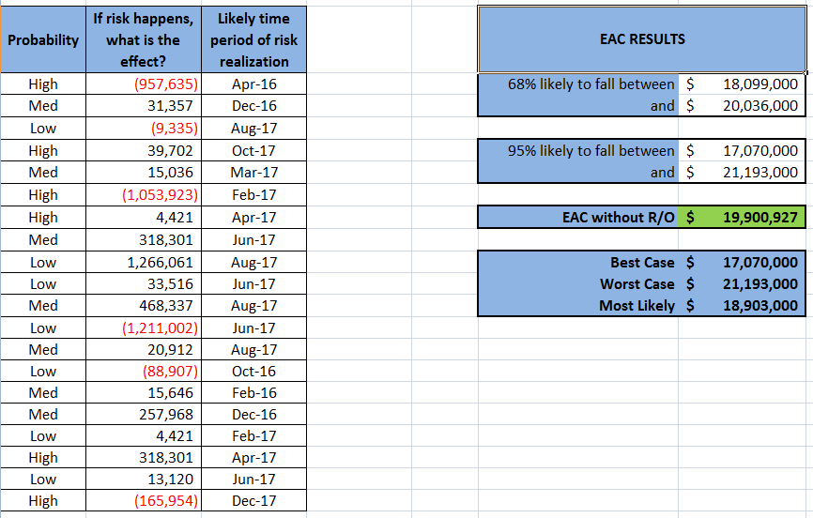
EXAMPLES

Slide 20
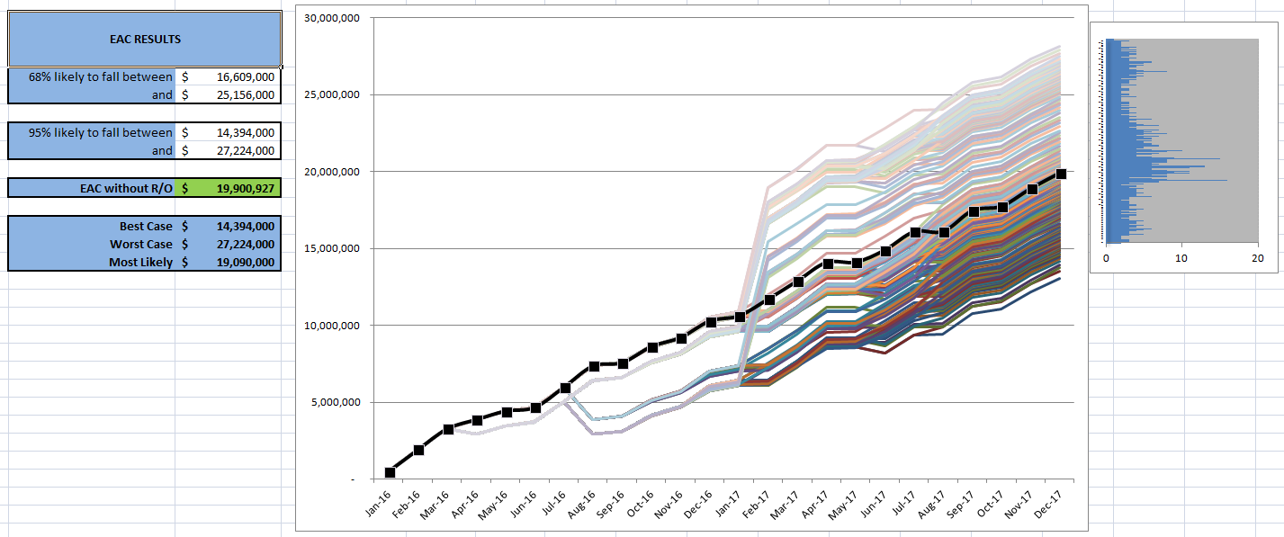
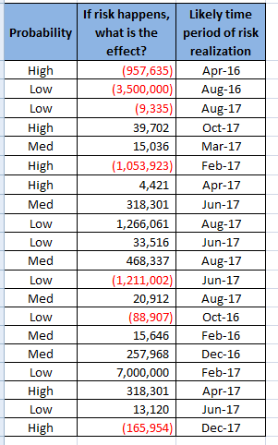
EXAMPLES

Slide 21
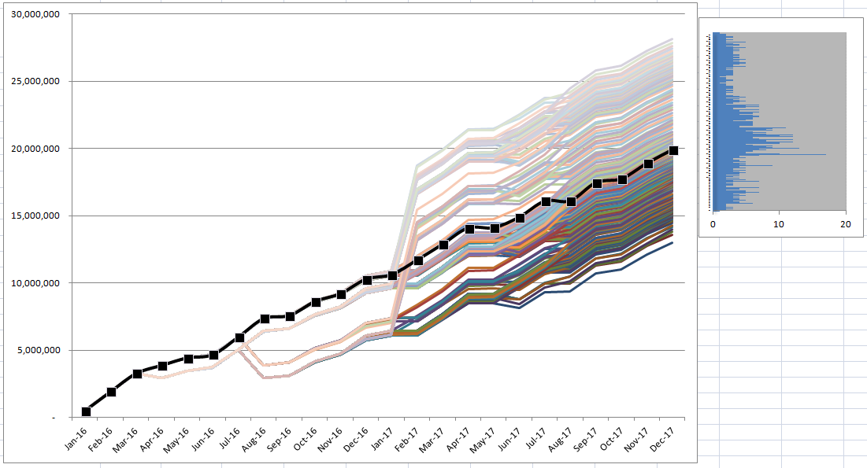
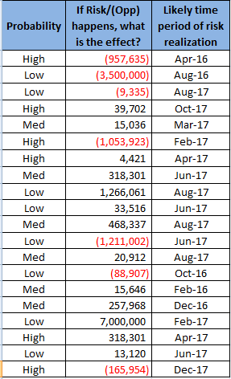
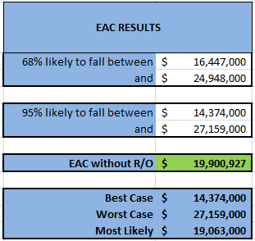
EXAMPLES

Slide 22
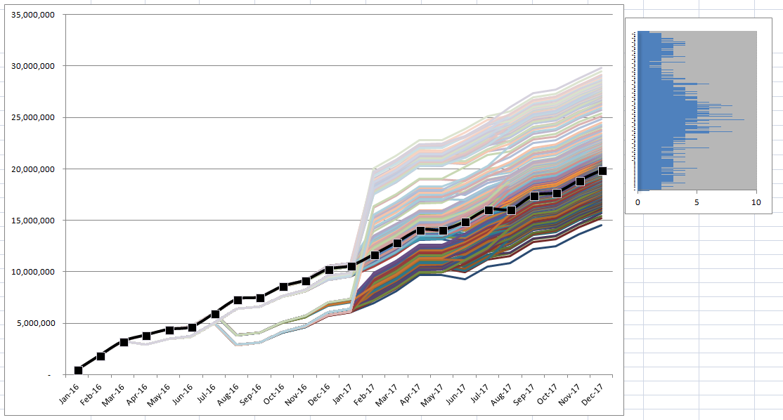
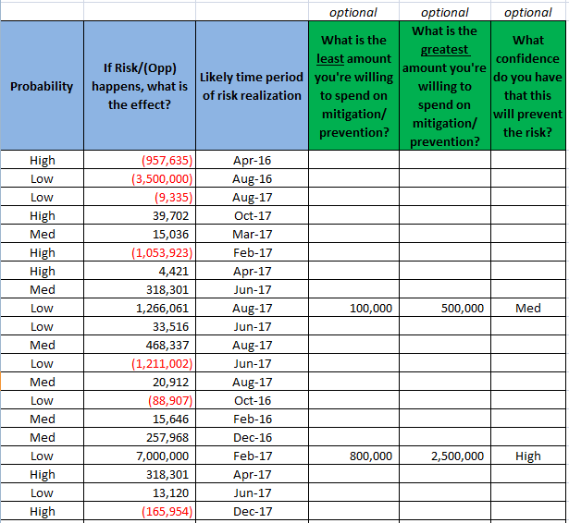
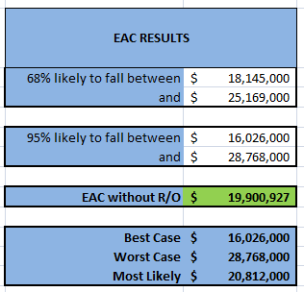
EXAMPLES
Mitigation here INCREASES EAC by $1.2M

Slide 23
EAC Multiverse Takeaway
So how do we do this?
Factoring and averaging muddles the data
The math to calculate this is—well, it’s hard. And often impossible.
Thanks to the Law of Large Numbers and a little VBA magic, we don’t need to do math (fist bump the person next to you)
Instead, Excel will literally simulate the program from beginning to end, and roll virtual dice according to each R/O probability
It takes about 10,000 iterations of the program to ensure with very high certainty that our cone of probable outcomes is accurate (this is called Monte Carlo simulation)
Thankfully, Excel is really good at this (another fist bump, please)
http://www.buzzle.com/articles/the-schrodingers-cat-paradox-explained.html

Slide 24
Demonstration
ENOUGH TALK!! LET’S SEE THE DATA MODEL IN ACTION

Slide 25
Conclusion
So what did we learn?
Traditional EAC calculations have limited actionable value
Cats make for fun scientific experiments
If you actively manage and cultivate your R/O’s, you can create an EAC multiverse
This gives you a much better idea of your cone of probable outcomes
This in turn allows you to make better decisions to improve your program, and creates an EAC range with an accurate context
Data modeling and simulation do the work so you can focus on R/O management and actually impact your program
http://www.buzzle.com/articles/the-schrodingers-cat-paradox-explained.html

Slide 26
Conclusion
REMEMBER—FORECASTING THE FUTURE IS GOOD, BUT
IT’S NOT THIS
IT’S THIS

Slide 27
Party Favor
Would you like to try using the data model?
If so, please contact me and I will happily send you a copy with instructions
I would love any feedback or suggestions for how to improve the process or the tool itself—this is an evolving project!
http://www.buzzle.com/articles/the-schrodingers-cat-paradox-explained.html

Slide 28
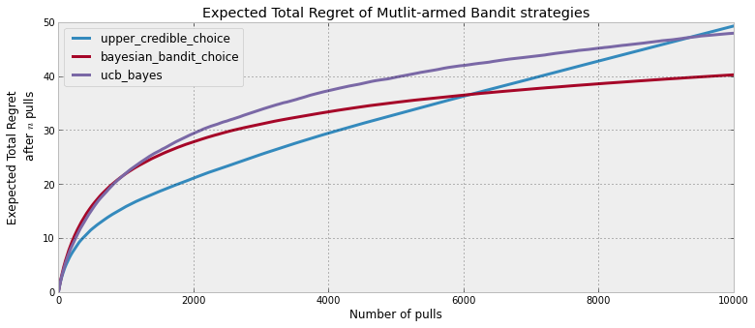
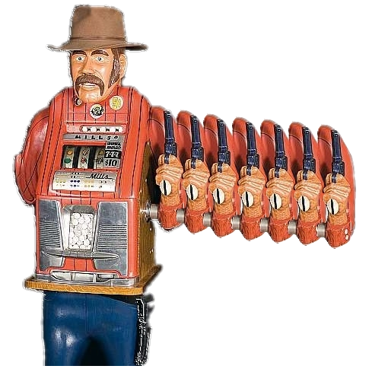
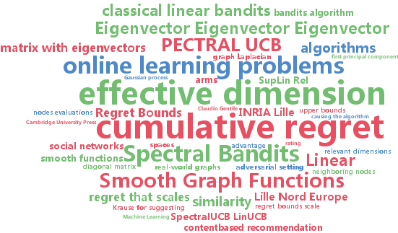
Preview of Next Version (coming Fall 2017)
http://www.kdnuggets.com/wp-content/uploads/machine-learning-api.jpeg

Slide 29
Title:
Using Quantum Theory, Monte Carlo, and the Multiverse to Predict EAC
Questions?

